Slide 1

AI 1A
Engr Muhammad Umer Haroon

Slide 2
Directions for Quiz
On top of your page write the following information.
Quiz no : 1
Name : e.g Muhammad Umer
Roll no : e.g 23P-512
Program e.g BS AI
Section e.g section A

Slide 3
Directions for Quiz
Don’t ask friend or teacher for explanation for question ,attempt as per your understanding.
No use of mobile ,no cheating ,no discussion …strict action will be taken.
Don’t write the question , understand it and only write answer e.g Answer 1 :
There is time limit for every question , as soon as time for that is over we will move to next question. If you keep on solving previous question you will run short of time for next question.
If a question’s time is over it won’t be displayed on screen , we will move to next question.
When time for last question is over, there will be count down from 10 to 1, before count down end must hand over the quiz to teacher ,failure to do so will result in ZERO marks.

Slide 4
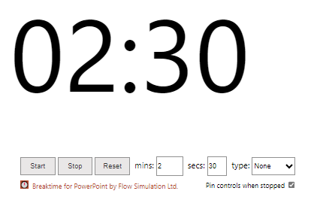
Q1 : marks =2
What purpose do comments serve? how many types do they have?
TIME
REMAINING

Slide 5
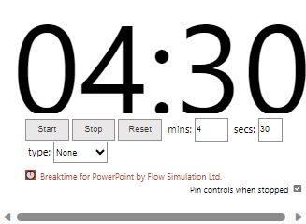
Q2 : marks =4
Stepwise solve following equation and write value of t, no need to write code
p = 25, q = 50, r = 75, s = 100
t= p * q / r + s - p % q
TIME
REMAINING

Slide 6
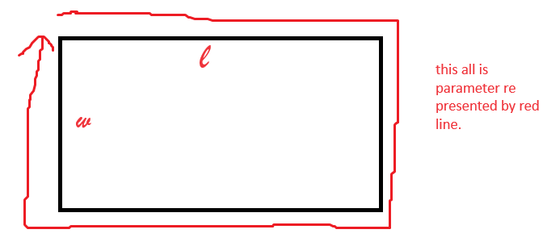
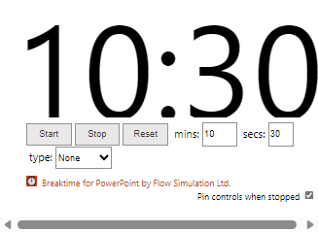
Q3 : marks =10
Write code to find parameter of rectangle, display it on screen, let length of one side be 15 and, width be 10. Look at figure to get an idea what is meant by parameter? Also write value of output. Also draw a flowchart for the said program.
TIME
REMAINING

Slide 7
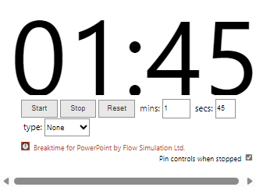
Q4 : marks =10
What will be the output of the program?
#include <stdio.h>
int main() {
int x = 5;
int y = 2;
float result = x / y;
printf("Result: %f\n", result);
return 0;
}
TIME
REMAINING

Slide 8
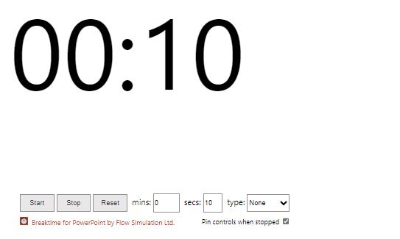
END COUNT DOWN

